Slide 1

Temporal Difference Learning
Notes:
1

Slide 2
Objectives
Define temporal-difference learning
Define the temporal-difference error
Understand the TD(0) algorithm
Temporal Difference Learning
2
Notes:
2

Slide 3
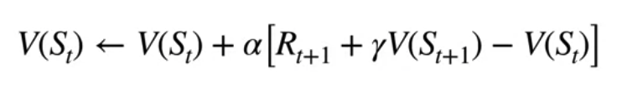
Temporal Difference
Temporal Difference (TD) learning is a reinforcement learning technique that combines elements of Monte Carlo methods and dynamic programming.
It is a model-free approach used to estimate value functions or policies directly from experience, without requiring a model of the environment's dynamics.
Temporal Difference Learning
3
Notes:
3

Slide 4
Temporal Difference
Temporal Difference Error:
At each time step, TD learning updates value estimates based on the temporal difference error, which is the difference between the expected return and the current estimate.
In other words, it updates the value estimate towards a better estimate of the true value, based on the difference between observed rewards and the predictions made by the current estimate.
Temporal Difference Learning
4
Notes:
4

Slide 5
Temporal Difference
TD Target:
The TD target is the sum of the immediate reward plus the estimated value of the next state, discounted by a factor γ. It represents the agent's expected return from the current state-action pair.
Temporal Difference Learning
5
Notes:
5

Slide 6
Temporal Difference
TD Error:
The TD error is the difference between the TD target and the current estimate of the value function.
It measures how much the current estimate needs to be adjusted to match the observed returns.
The temporal-difference (TD) error, often denoted as δt, is a key concept in temporal-difference learning in reinforcement learning.
It represents the discrepancy between the predicted value of a state or state-action pair and the observed return obtained from the environment at a given time step.
Temporal Difference Learning
6
Notes:
6

Slide 7
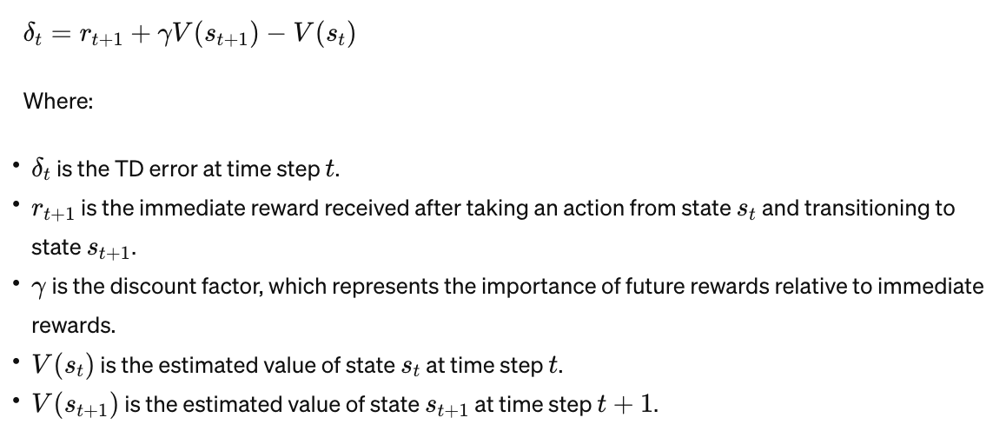
Temporal Difference
TD Error:
The TD error at time step t is defined as:
Temporal Difference Learning
7
Notes:
7

Slide 8
Temporal Difference
TD Error:
The TD error measures the difference between the expected value of the current state and the sum of the immediate reward and the discounted value of the next state.
It indicates how much the current estimate of the value function needs to be adjusted to match the observed return.
Temporal-difference learning algorithms use the TD error to update value estimates iteratively, adjusting the estimates towards the observed returns in order to improve the accuracy of value function estimates and guide the agent's decision-making process.
Temporal Difference Learning
8
Notes:
8

Slide 9
Temporal Difference
Temporal Difference Update Rule:
TD learning algorithms update value estimates iteratively based on TD errors.
The value estimates are adjusted towards the TD target by a small step size α, known as the learning rate.
The update rule is typically of the form:
Temporal Difference Learning
9
Notes:
9

Slide 10
Temporal Difference
Policy Improvement:
TD learning can be used for policy improvement by estimating action values (Q-values) and selecting actions based on the estimated values. Q-learning is a popular TD learning algorithm that learns action values and selects actions greedily based on the estimated Q-values.
Temporal Difference Learning
10
Notes:
10

Slide 11
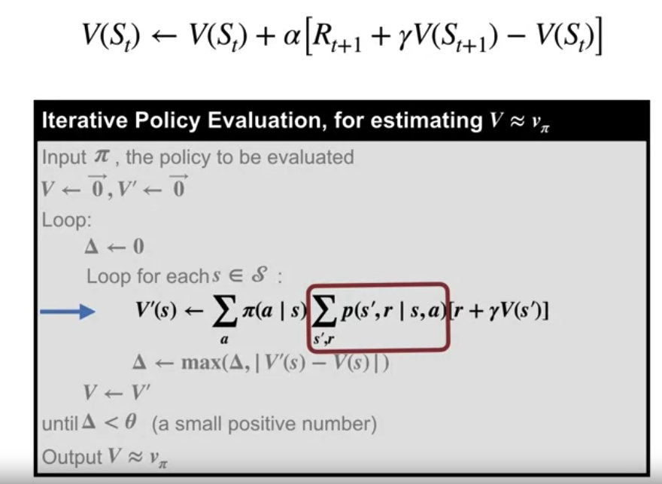
Temporal Difference
Temporal Difference Learning
11
Notes:
11

Slide 12
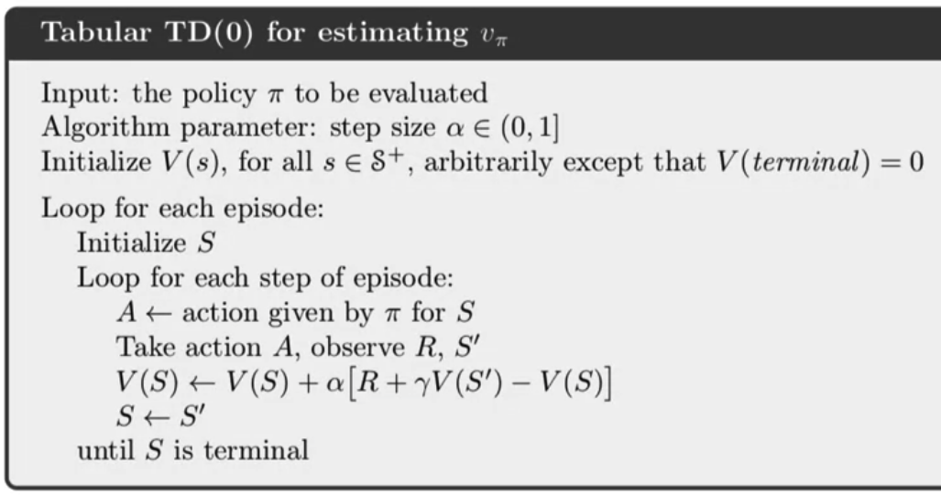
Temporal Difference
The tabular TD zero algorithms.
Temporal Difference Learning
12
Notes:
12

Slide 13
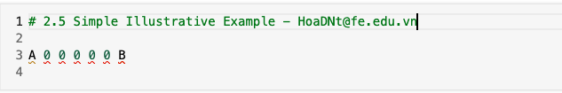
Temporal Difference
Simple illustrative example:
We have a simplified grid world environment where an agent can move left or right. The agent starts at position A and the goal is to reach position B, where it receives a reward of +1. The agent receives a reward of 0 for all other states.
Temporal Difference Learning
13
Notes:
13

Slide 14
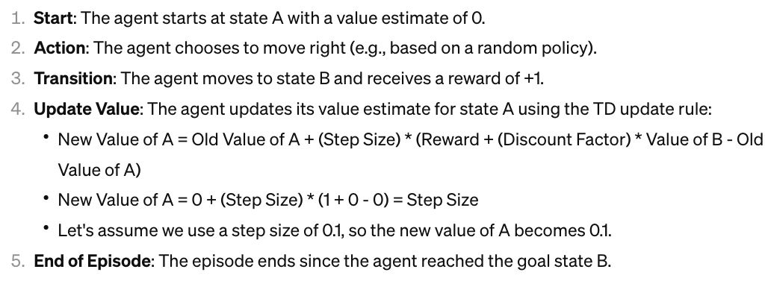
Temporal Difference
Simple illustrative example:
Episode of the agent's interaction with the environment using TD learning:
Temporal Difference Learning
14
Notes:
14

Slide 15
Temporal Difference
Simple illustrative example:
the agent's value estimate for state A has been updated based on the observed reward and the estimated value of the next state B.
The agent continues to interact with the environment over multiple episodes, updating its value estimates after each step using the TD update rule.
Over time, the agent's value estimates converge to the true values, allowing it to make better decisions and ultimately reach the goal more efficiently.
Temporal Difference Learning
15
Notes:
15

Slide 16
Summary
Define temporal-difference learning
Define the temporal-difference error
Understand the TD(0) algorithm
Temporal Difference Learning
16

Slide 17
Q & A
Temporal Difference Learning
17

